Slide 1

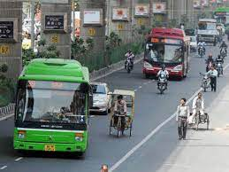
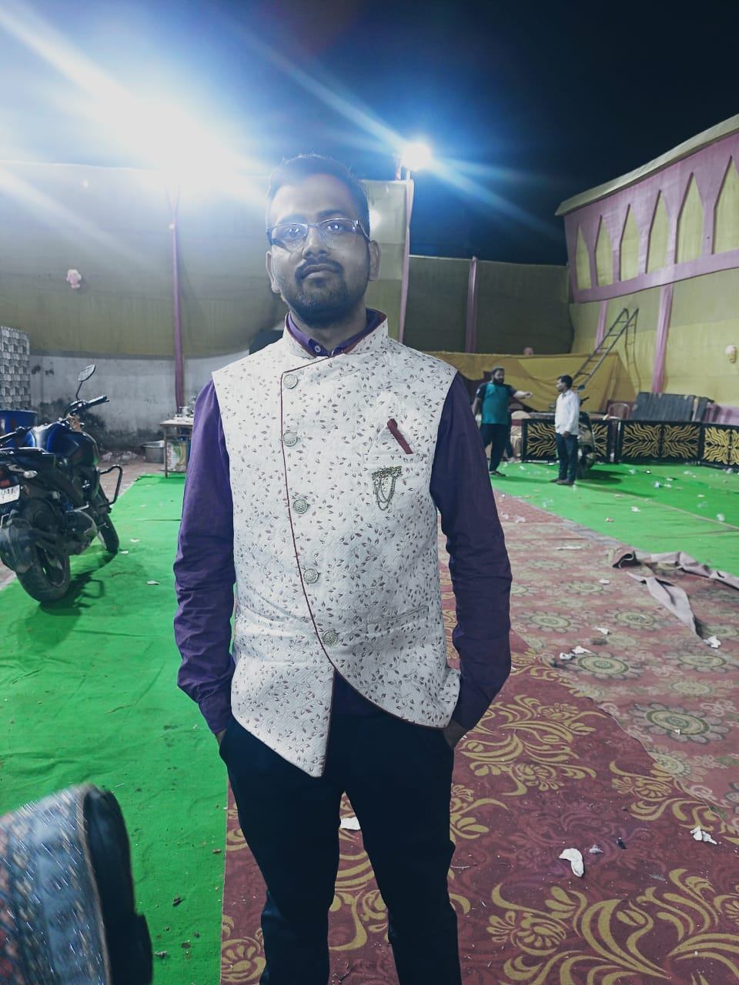
Capstone Project-2
Demand Prediction for Public Transport by Ashveen Kumar Verma (Self)

Slide 2

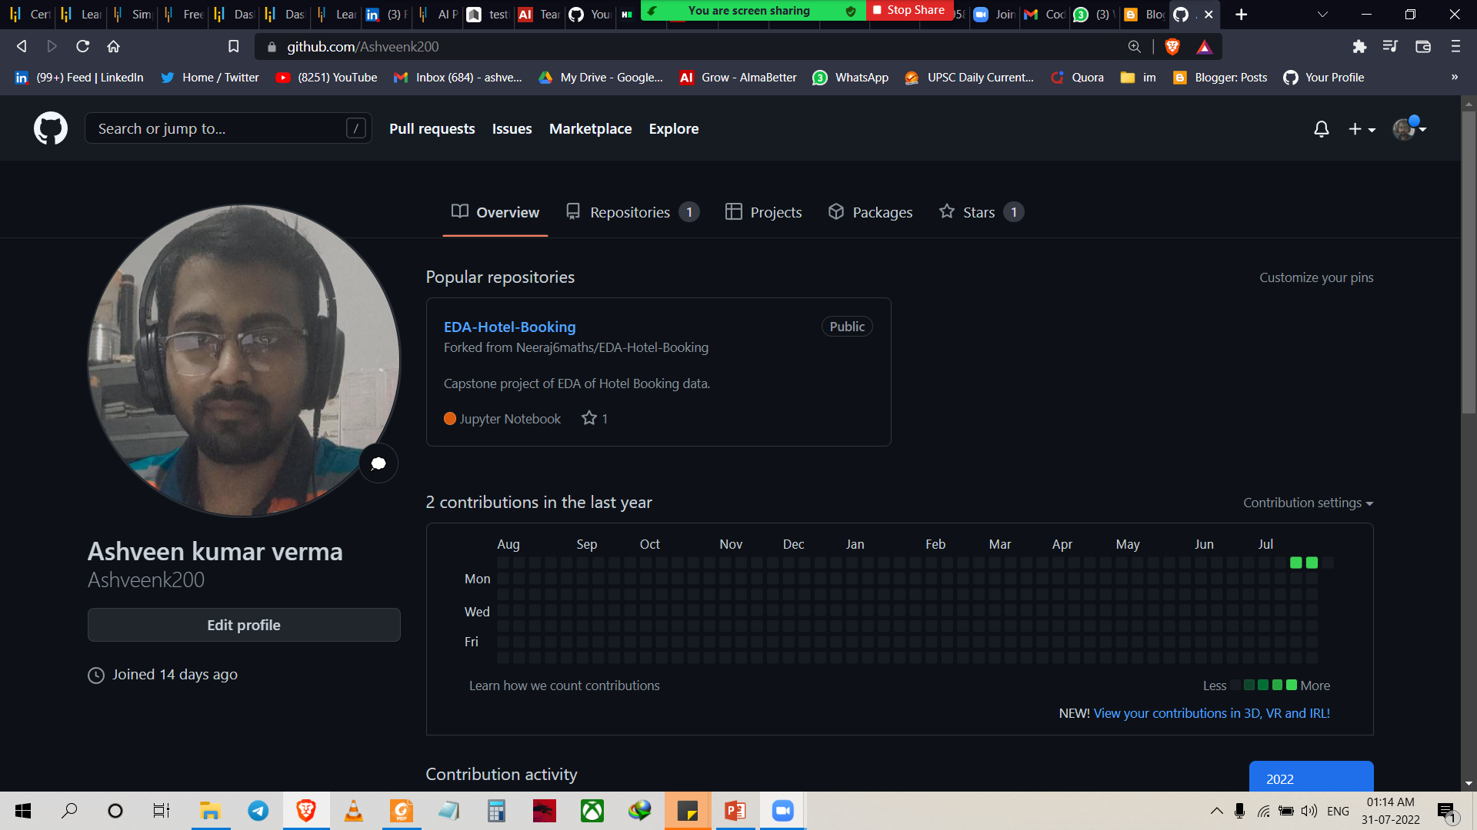
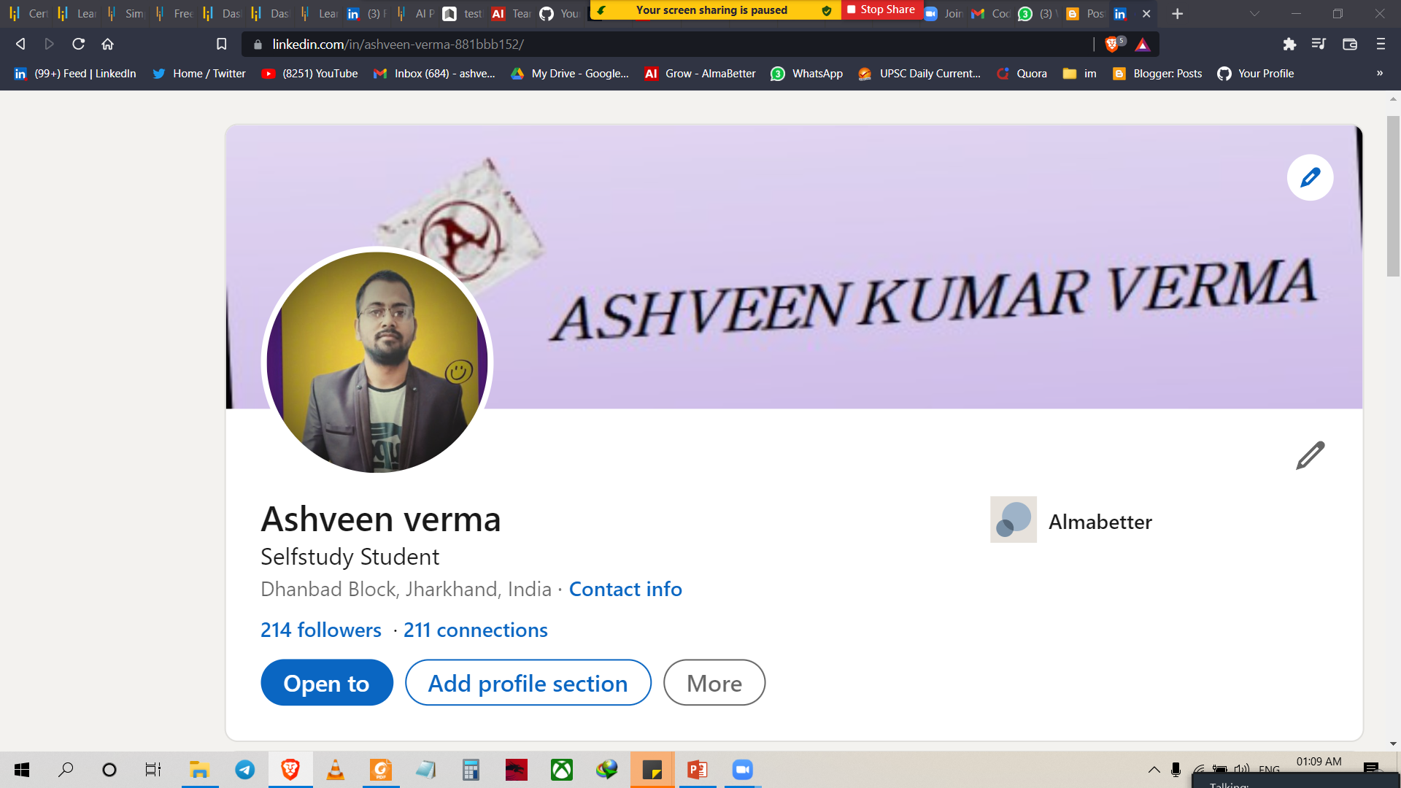
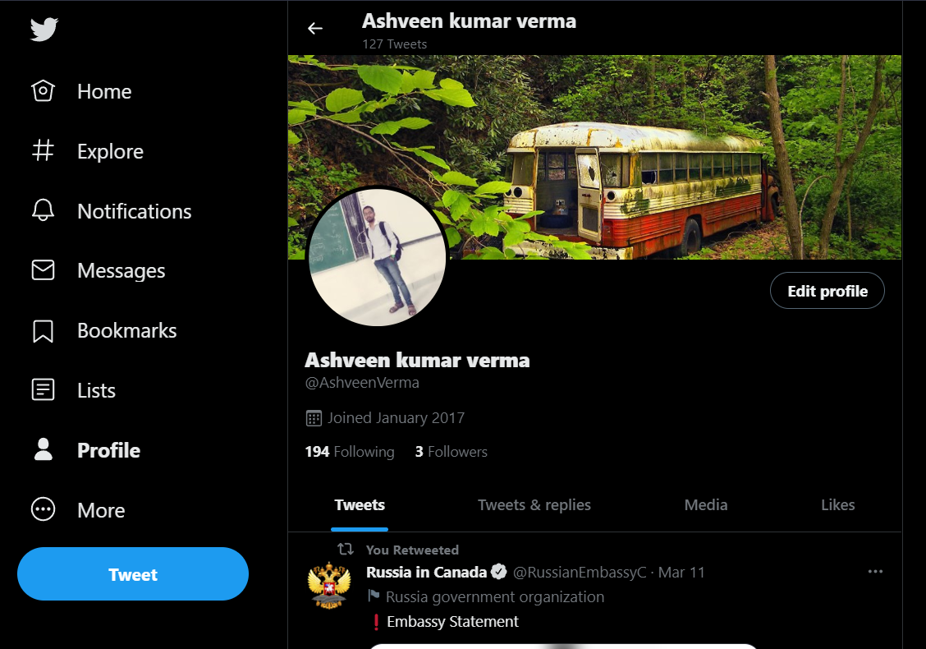
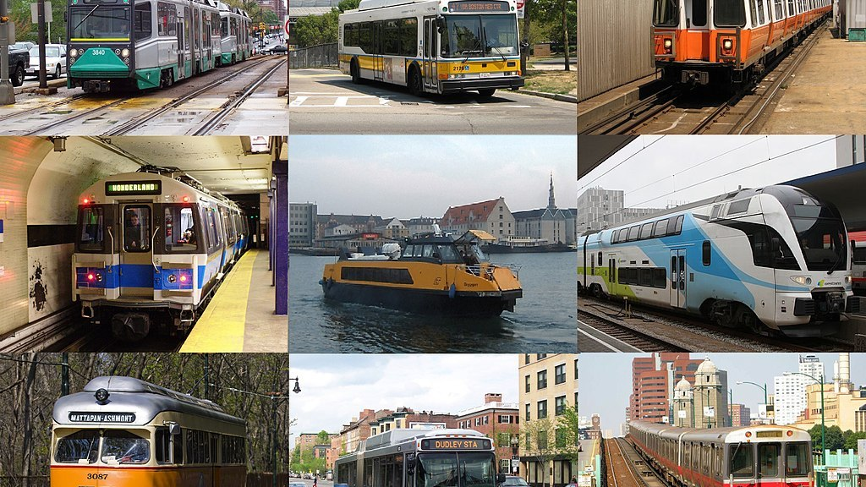
ASHVEEN KUMAR VERMA
Live in Dhanbad Jharkhand
Bsc graduate from pk roy memorial collage Dhanbad in 2020.
Enrolled in DS program.
This is my 2nd capstone project
Linkedin- Ashveen verma
Github- Ashveen kumar verma
Twitter- Ashveen kumar verma

Slide 3
Project: Traffic Jam: Predicting People's Movement into Nairobi
Problem Description
This challenge asks you to build a model that predicts the number of seats that Mobiticket can expect to sell for each ride, i.e. for a specific route on a specific date and time. There are 14 routes in this dataset. All of the routes end in Nairobi and originate in towns to the North-West of Nairobi towards Lake Victoria.

Slide 4
Work Flow:-
The towns from which these routes originate are:
Awendo
Homa Bay
Kehancha
Kendu Bay
Keroka
Keumbu
Kijauri
Kisii
Mbita
Migori
Ndhiwa
Nyachenge
Oyugis
Rodi
Rongo
Sirare
Sori

Slide 5
After collecting data it’s important to understand your data . So we had 51645 rows and 10 columns. So lets understand this 10 columns.
ride_id
seat_number
payment_method
payment_receipt
travel_date
travel_time
travel_from
travel_to
car_type
max_capacity

Slide 6
The routes from these 14 origins to the first stop in the outskirts of Nairobi takes approximately 8 to 9 hours from time of departure. From the first stop in the outskirts of Nairobi into the main bus terminal, where most passengers get off, in Central Business District, takes another 2 to 3 hours depending on traffic. The three stops that all these routes make in Nairobi (in order) are: Kawangware: the first stop in the outskirts of Nairobi Westlands Afya Centre: the main bus terminal where most passengers disembark Passengers of these bus (or shuttle) rides are affected by Nairobi traffic not only during their ride into the city, but from there they must continue their journey to their final destination in Nairobi wherever that may be. Traffic can act as a deterrent for those who have the option to avoid buses that arrive in Nairobi during peak traffic hours. On the other hand, traffic may be an indication for people’s movement patterns, reflecting business hours, cultural events, political events, and holidays.

Slide 7
Data Description Nairobi Transport Data.csv (zipped) is the dataset of tickets purchased from Mobiticket for the 14 routes from “up country” into Nairobi between 17 October 2017 and 20 April 2018. This dataset includes the variables: ride_id, seat_number, payment_method, payment_receipt, travel_date, travel_time, travel_from, travel_to, car_type, max_capacity. Data is available for Nairobi through June 2018. Uber Movement provided historic hourly travel time between any two points in Nairobi. Any tables that are extracted from the Uber Movement platform can be used in my model. Variables description: ride_id: unique ID of a vehicle on a specific route on a specific day and time. seat_number: seat assigned to ticket payment_method: method used by customer to purchase ticket from Mobiticket (cash or Mpesa) payment_receipt: unique id number for ticket purchased from Mobiticket travel_date: date of ride departure. (MM/DD/YYYY) travel_time: scheduled departure time of ride. Rides generally depart on time. (hh:mm) travel_from: town from which ride originated travel_to: destination of ride. All rides are to Nairobi. car_type: vehicle type (shuttle or bus) max_capacity: number of seats on the vehicle

Slide 8
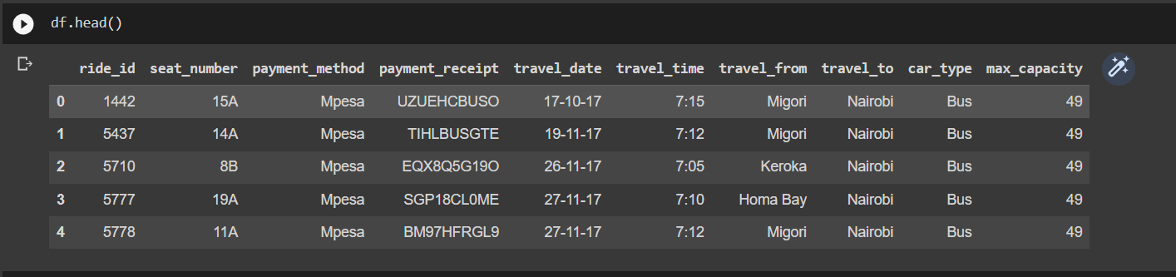
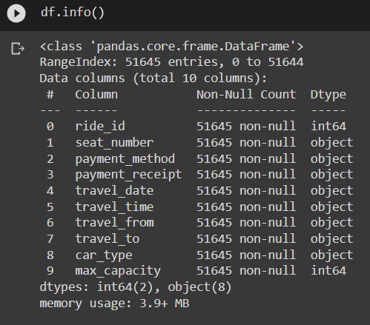
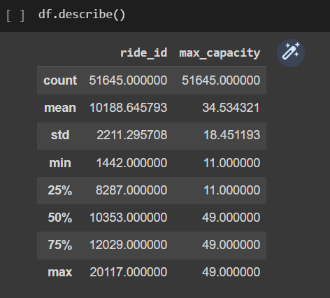
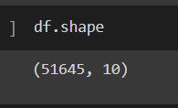
Data cleaning and Manupulation :-

Slide 9
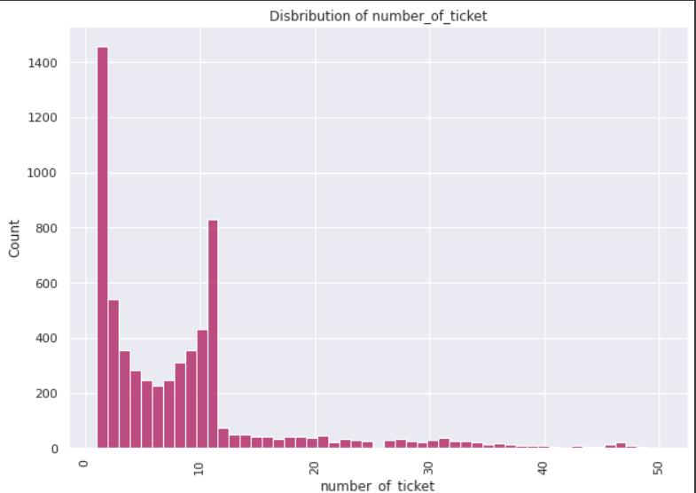

Exploratory Data Analysis(EDA)

Slide 10
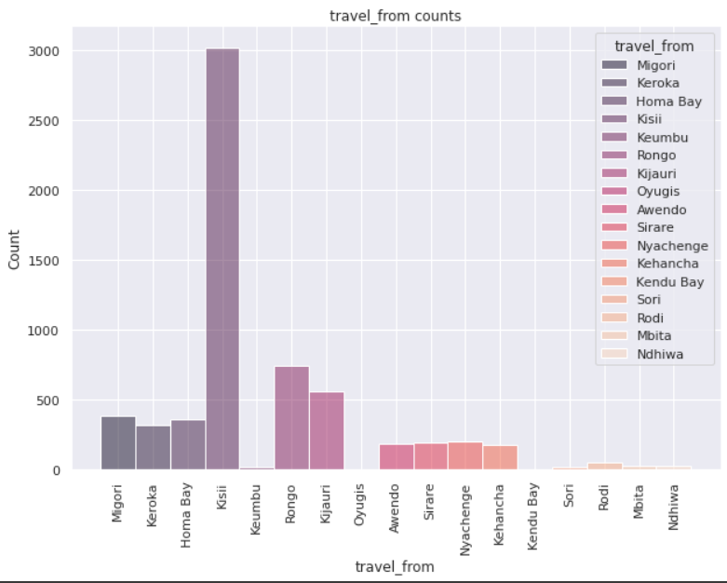
Exploratory Data Analysis(EDA)
Conclusion:-
The graph shows kisii has maximum number of bookings and ndhiwa have lowest number of bookings for travel
Here we also conclude that kisii may be a tourist hotspot of very religious place.

Slide 11
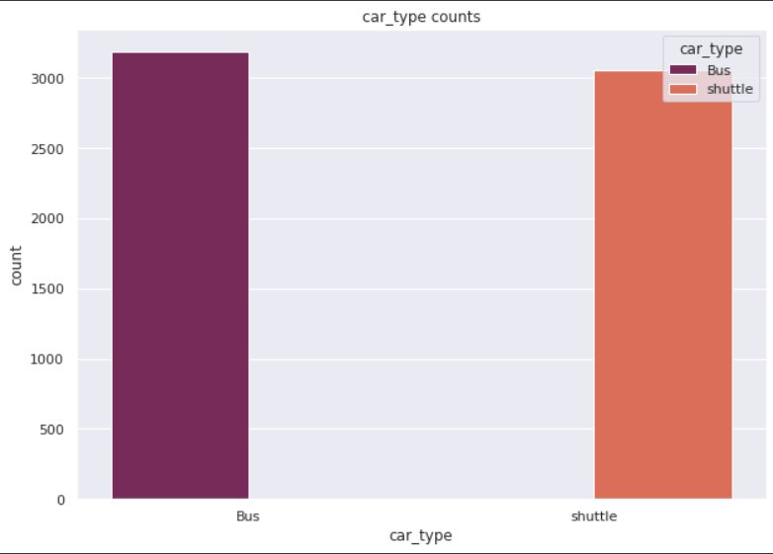
Exploratory Data Analysis(EDA)
Conclusion
From graph we say that passengers travels from bus and shuttle rather than train.
Buses value is quite higher than shuttle.

Slide 12
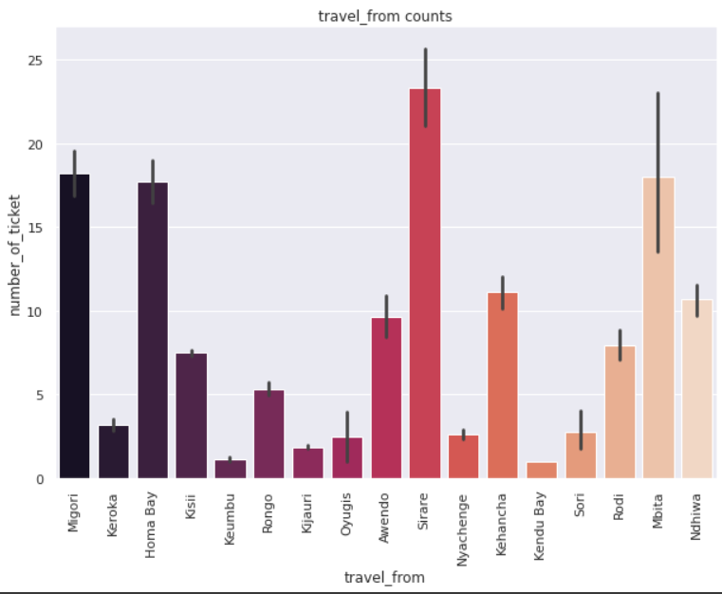
Exploratory Data Analysis(EDA)
Most of the people in sirare and keumbu and kendu bay has least travel_from_count.
BB(bed & Beakfast ) is the most preffered type of meal by the guests.
Full board (FB) is least preffered.
HB and SC are equally preferred.

Slide 13
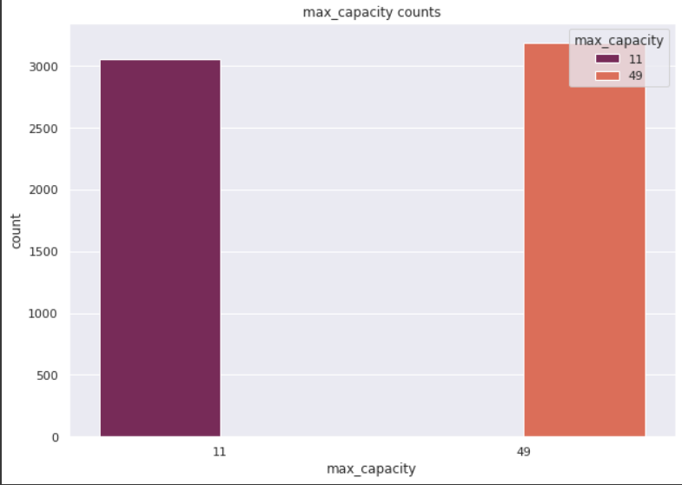
Exploratory Data Analysis(EDA)
Conclusion
From graph we can say that the maximum capacity is of 11 and 49 is 3000 and 3500 approximately.

Slide 14
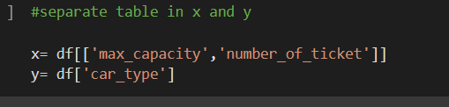
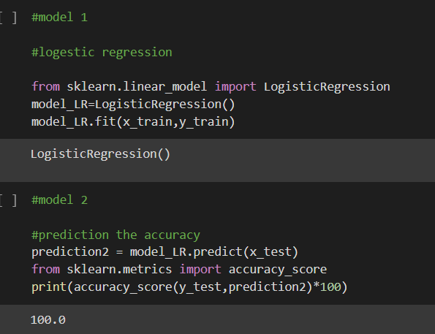
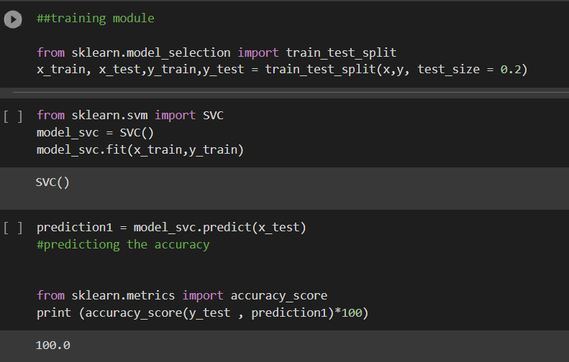
Model building and pridection :

Slide 15
Conclusion
In this project, we have used regression-based algorithms like linear regression and we found the important features for training the model. In the linear regression model Regressor algorithm gives the best results with an accuracy of around 100%.

Slide 16


